Slide 1
APOLOGETICS
IN ONE LESSON
almost
Ai1L.net
Lesson 10
“Christians believe by ‘faith’, not facts”

Slide 2
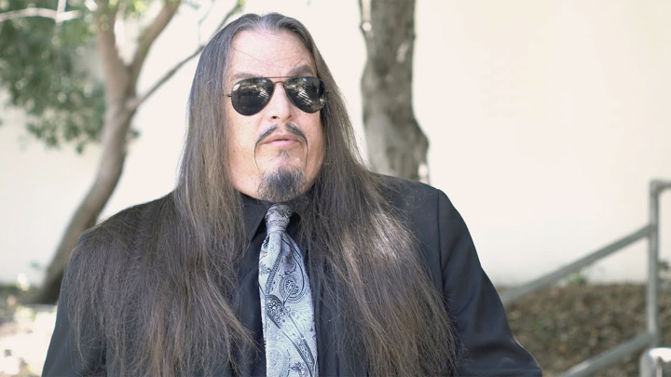
ARON RA Former president of the Atheist Alliance of America

Slide 3
“But universities are about reason, pure and simple. Faith—believing something without good reasons to do so —has no place in anything but a religious institution, and our society has no shortage of these.”
STEVEN PINKER Less Faith, More Reason

Slide 4
Summarize the critics' viewpoint
1

Slide 5
List out the claims
2

Slide 6
What questions would you ask this person?
3

Slide 7
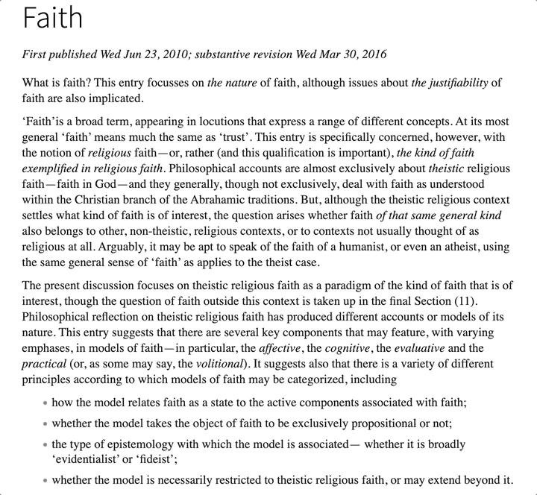
Definition of faith
STANFORD ENCYCLOPEDIA OF PHILOSOPHY https://plato.stanford.edu/entries/faith/

Slide 8
Hebrews 11:1
4

Slide 9
Noah | Built an ark for a future flood
Abraham | Left his homeland to a yet unknown location
Sarah | Believed the promise of a future pregnancy
Joseph | Spoke of the coming exodus
Moses | Valued disgrace for Christ (and future reward)
Rahab | Saved the spies so she could be later saved

Slide 10
“pertaining to being worthy of belief or trust , trustworthy, faithful, dependable, inspiring trust/faith”
πιστός (faith) A Greek-English Lexicon of the New Testament and Other Early Christian Literature, 3rd Edition

Slide 11
John 20:29
5

Slide 12
More “faith”ful
Less “faith”ful
A
B
“I believe without reasons”
“I believe with reasons”
Low knowledge of the evidence
High knowledge of the evidence
Faith: believing without reason or evidence (as a thought experiment)

Slide 13
✓
Abraham
✓
✕
Isaac
Ishmael
✓
✕
Jacob
Esau
✓
Jesus

Slide 14
2 Corinthians 4:18 and 2 Corinthians 5:7
6

Slide 15
“Convictions are about what matters to us . Most importantly, they signify to others what kind of person – parent, friend, citizen – we take ourselves to be They reflect our self-identity .”
Michael Patrick Lynch ‘Always Sticking to Your Convictions’ Sounds Like a Good Thing – But It Isn’t

Slide 16
List other verses that indicate that faith is not an irrational act
7

Slide 17
“God’s dikaiosyne [righteousness] is not an attribute but a power , namely, ‘a power that brings salvation to pass.’”
Fleming Rutledge The Crucifixion (page 328)

Slide 18
“God’s dikaiosyne [righteousness] is not an attribute but a power , namely, ‘a power that brings salvation to pass.’”
FLEMING RUTLEDGE The Crucifixion (page 328)

Slide 19
“God has no attitudes which are not actions; the two things are one .”
Austin Farrer Saving Belief (page 106)

Slide 20
List examples of Christians in the New Testament that had been skeptical but came to believe that Jesus resurrected
8

